Slide 1
User Requirements
Lecturer: Ngo Huy Bien
Software Engineering Department
Faculty of Information Technology
VNUHCM - University of Science
Ho Chi Minh City, Vietnam
nhbien@fit.hcmus.edu.vn

Slide 2

Objectives
To discover user requirements.
To create a project vision and scope document.

Slide 3

Contents
User Requirements
Glossary
Business Rules
Features
Feature Model
Feature Tree
Project Vision and Scope
Project Scope Statement

Slide 4

References
Craig Larman (2004). Applying UML and Patterns. 3rd Edition. Prentice Hall.
Don Batory (2005). Feature Models, Grammars, and Propositional Formulas.
Karl Wiegers and Joy Beatty (2013). Software Requirements. Microsoft Press.
Jennifer Greene and Andrew Stellman (2005). Applied Software Project Management. O'Reilly Media.
Andrew Stellman and Jennifer Greene (2014). Head First PMP. 3rd Edition. O'Reilly Media.

Slide 5

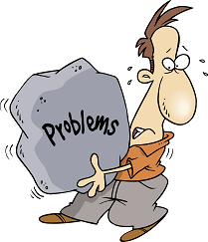


Discovering User Requirements
Who are the users?
What are their problems, needs or goals?
No software or black box software.
Refer to 05.2. Business Use Cases.pptx and 05.3. Domain Models.pptx for details.

Slide 6
Glossary [1]
Glossary defines noteworthy terms, records requirements related to data, such as validation rules, acceptable values, and so forth.
Term | Definition and Information | Format | Validation Rules | Aliases
Item | A product or service for sale
Payment authorization | Validation by an external payment authorization service that they will make or guarantee the payment to the seller.
Payment authorization request | A composite of elements electronically sent to an authorization service, usually as a char array. Elements include: store ID, customer account number, amount, and timestamp.
UPC | Numeric code that identifies a product. Usually symbolized with a bar code placed on products. See www.gs1us.org for details of format and validation. | 12-digit code of several subparts. | Digit 12 is a check digit. | Universal Product Code

Slide 7
Business Rules
Business rules dictate how a domain or business may operate.
ID | Rule | Changeability | Source
RULE1 | Signature required for credit payments. | Buyer "signature" will continue to be required, but within 2 years most of our customers want signature capture on a digital capture device, and within 5 years we expect there to be demand for support of the new unique digital code "signature" now supported by USA law. | The policy of virtually all credit authorization companies.
RULE2 | Tax rules. Sales require added taxes. See government statutes for current details. | High. Tax laws change annually, at all government levels. | law

Slide 8

Features [2]
A feature is an end-user visible characteristic of a system.

Slide 9
How to Specify a Feature?
User | Business goal | Metric | Action
Kathy (Support) | Costly calls to customers | Number of call deflection | Create knowledge based articles based on common search terms
Michael (HR) | Employee satisfaction | Number of candidates for every job opening Retention rate | Create integrated recruiting tool

Slide 10
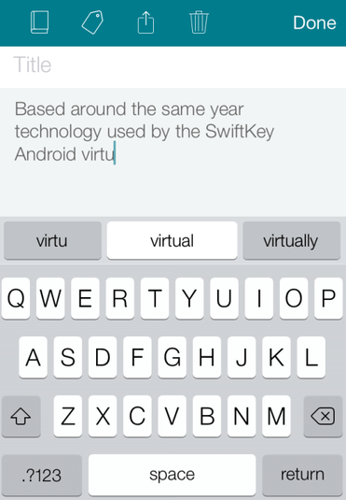
How to Indentify a Correct Feature?
Spot the problem
Talk to a client
Talk to two
Find two other clients in that same industry
Understand it
Just listen and understand their problem
Prototype it
Walk them through how you imagine it working.
Are they confused? Are they excited?
Inspect them
Build a functioning prototype and watch them use it

Slide 11
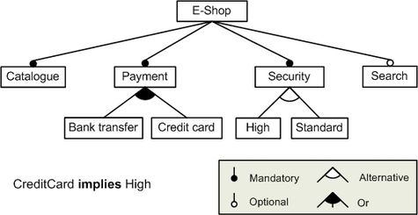
Sub-features
A feature can be decomposed into several sub-features.
Relationships between a parent (or compound) feature and its child features (or sub-features) are categorized as:
And — all sub-features must be selected,
Alternative — only one sub-feature can be selected,
Or — one or more can be selected,
Mandatory — features that required, and
Optional — features that are optional.

Slide 12
Feature Model
A feature model is a hierarchically arranged set of features.
A feature diagram is a graphical representation of a feature model.

Slide 13
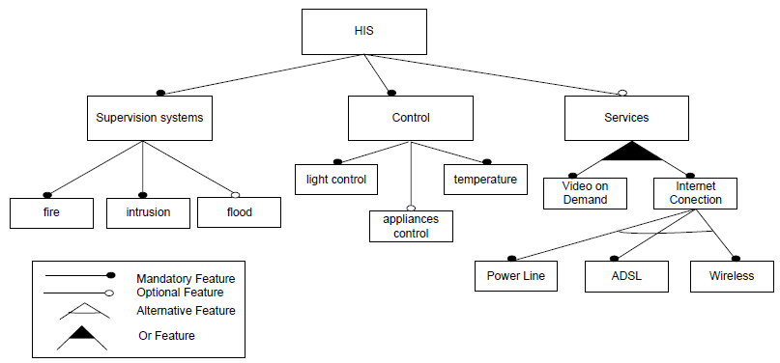
Example

Slide 14
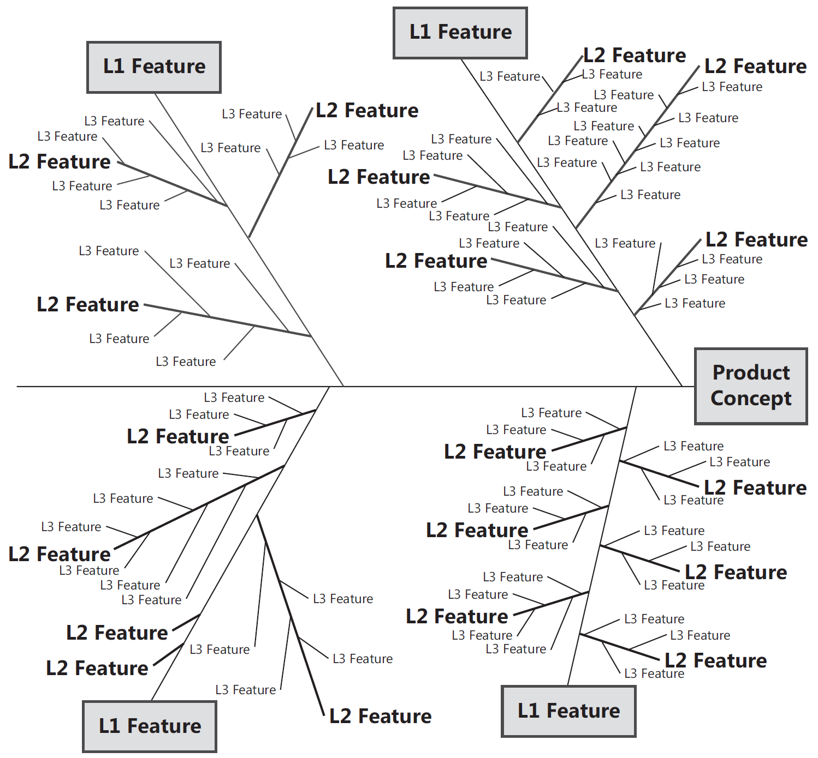
Feature Tree
A feature tree hierarchically structures the set of features of a system.
Simpler than feature model: only AND relationship.

Slide 15
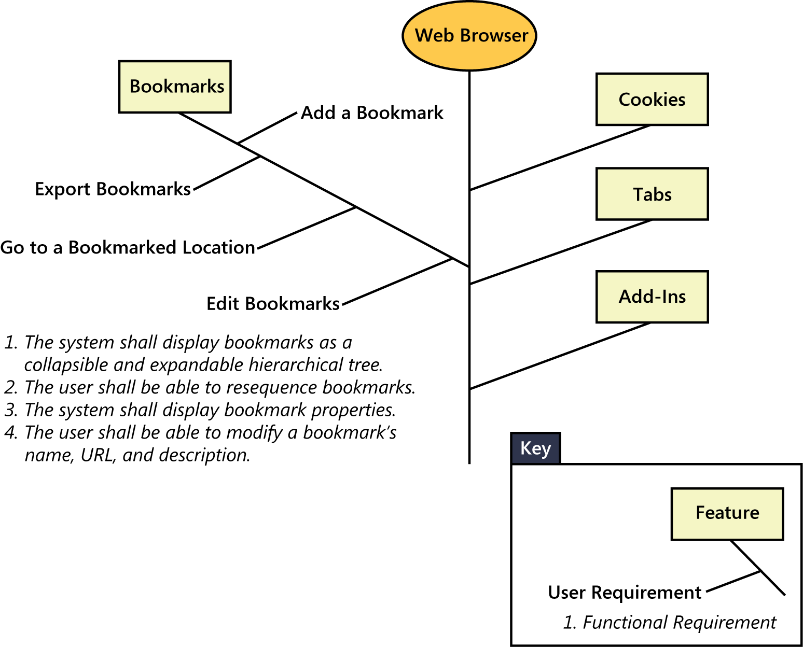
Feature Tree Example [3]

Slide 16


Slide 17

Project Vision and Scope [4]
A project vision and scope is the picturing of the project's deliverable as the solution to the stated need or problem.
The background, context, overview.
The current business use cases.
The current domain model.
The current users' problems, and their corresponding objectives.
The components and features that will be developed to obtain the users' objectives.
The components and features that will be excluded.
The future business use cases.
The future domain model.
The assumptions, the risks.
The conclusion.
Vision and Scope Document
Black box solution

Slide 18
Project Scope Statement [5]
Project scope statement: The description of the project scope, major deliverables, assumptions, and constraints.
The project scope statement tells what work you are—and are not—going to do in the project.
Example content:
Product scope description
Project exclusions
Project deliverables
Project acceptance criteria
Project constraints
Project assumptions

Slide 20
Further Reading
David Lorge Parna and Jan Madey (1995). Functional Documents for Computer Systems.
NAT, REQ, IN, OUT and SOF.
Carl A. Gunter et al. (1998). A Reference Model for Requirements and Specifications.
WRSPM reference model.

Slide 21

Thank You & See You Again

